Slide 1
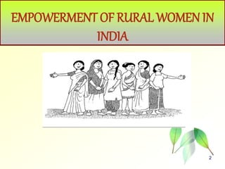
SMT. B. D. JAIN GIRLS P.G COLLEDE
WELCOME TO MY RESEARCH PROJECT ON
ECONOMICS DEVELOPMENT ON RURAL WOMEN
SUBMITTED BY:
KANCHAN SHRIVASTAV
D/O MR. ADESH SHRIVASTAV
B.A( SIXTH SEMESTER)
ROLL NO : 2200050011097
SUBMITTED TO
MRS. GARIMA MAM &
ANURADHA MAM

Slide 2
ACKNOWLEDEMENT
Everyone who support me to do this wonderful research report and I know lots of new things while doing this research first and foremost, I am deeply grateful to Dr. GARIMA MAM our Economics Instructor, for their invaluable guidance, support and encouragement throughout this project. Their expertise and insights have been instrumental in shaping my understanding and execution of the practical. I would also like to acknowledge the support of my classmates and friend

Slide 3
CERTIFICATE
This is certificate that KANCHAN SHRIVASTAV student of (sixth semester).
Has successfully completed the research report of Economics Development Of Rural Women.
Under my super vision. She has in partial fulfillment of the requirement of the degree of Bachelor of Art.
At SMT. B.D. JAIN GIRLS P.G COLLEGE. We acknowledge the diligent effort, dedication and comprehensive research demonstrated in this report.

Slide 4
ECONOMIC DEVELOPMENT OF RURAL WOMEN
Rural women are key agents for development. They play a catalytic role towards achievement of transformational economic, environmental and social changes required for sustainable development. But limited access to credit, health care and education are among the many challenges they face.

Slide 5
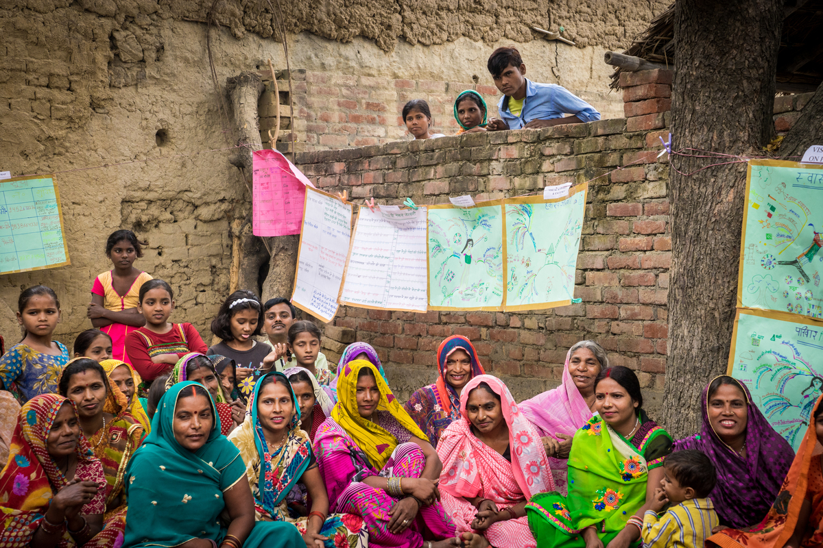

Slide 6
GLOBAL INITIATION
Providing women in rural areas with access to quality education and training programs enhances their skills and knowledge, enabling them to participate more effectively in economic activities.
Facilitating access to financial services such as microfinance, savings, and credit can empower rural women to start and expand their businesses, invest in assets, and manage household finances independently.

Slide 7
WOMEN ROLE IN ECONOMIC
Women are often primary contributors to rural economies, engaging in various economic activities such as agriculture, livestock rearing, handicrafts, and small-scale enterprises. Their labor forms the backbone of rural production systems and sustains livelihoods.
Women entrepreneurs in rural areas demonstrate resilience, creativity, and resourcefulness in establishing and managing businesses. They play pivotal roles in sectors like agribusiness, artisanal production, and eco-tourism, driving local economic growth and innovation.

Slide 8
CONCLUSION
women's economic empowerment in rural areas is not just a matter of gender equality; it's a fundamental driver of sustainable development, poverty reduction, and social progress. Throughout rural communities worldwide, women play pivotal roles across various spheres, from agriculture and entrepreneurship to community development and advocacy. Their contributions are indispensable for building resilient, inclusive, and thriving rural economies.

Slide 9
THANK YOU

